Slide 1
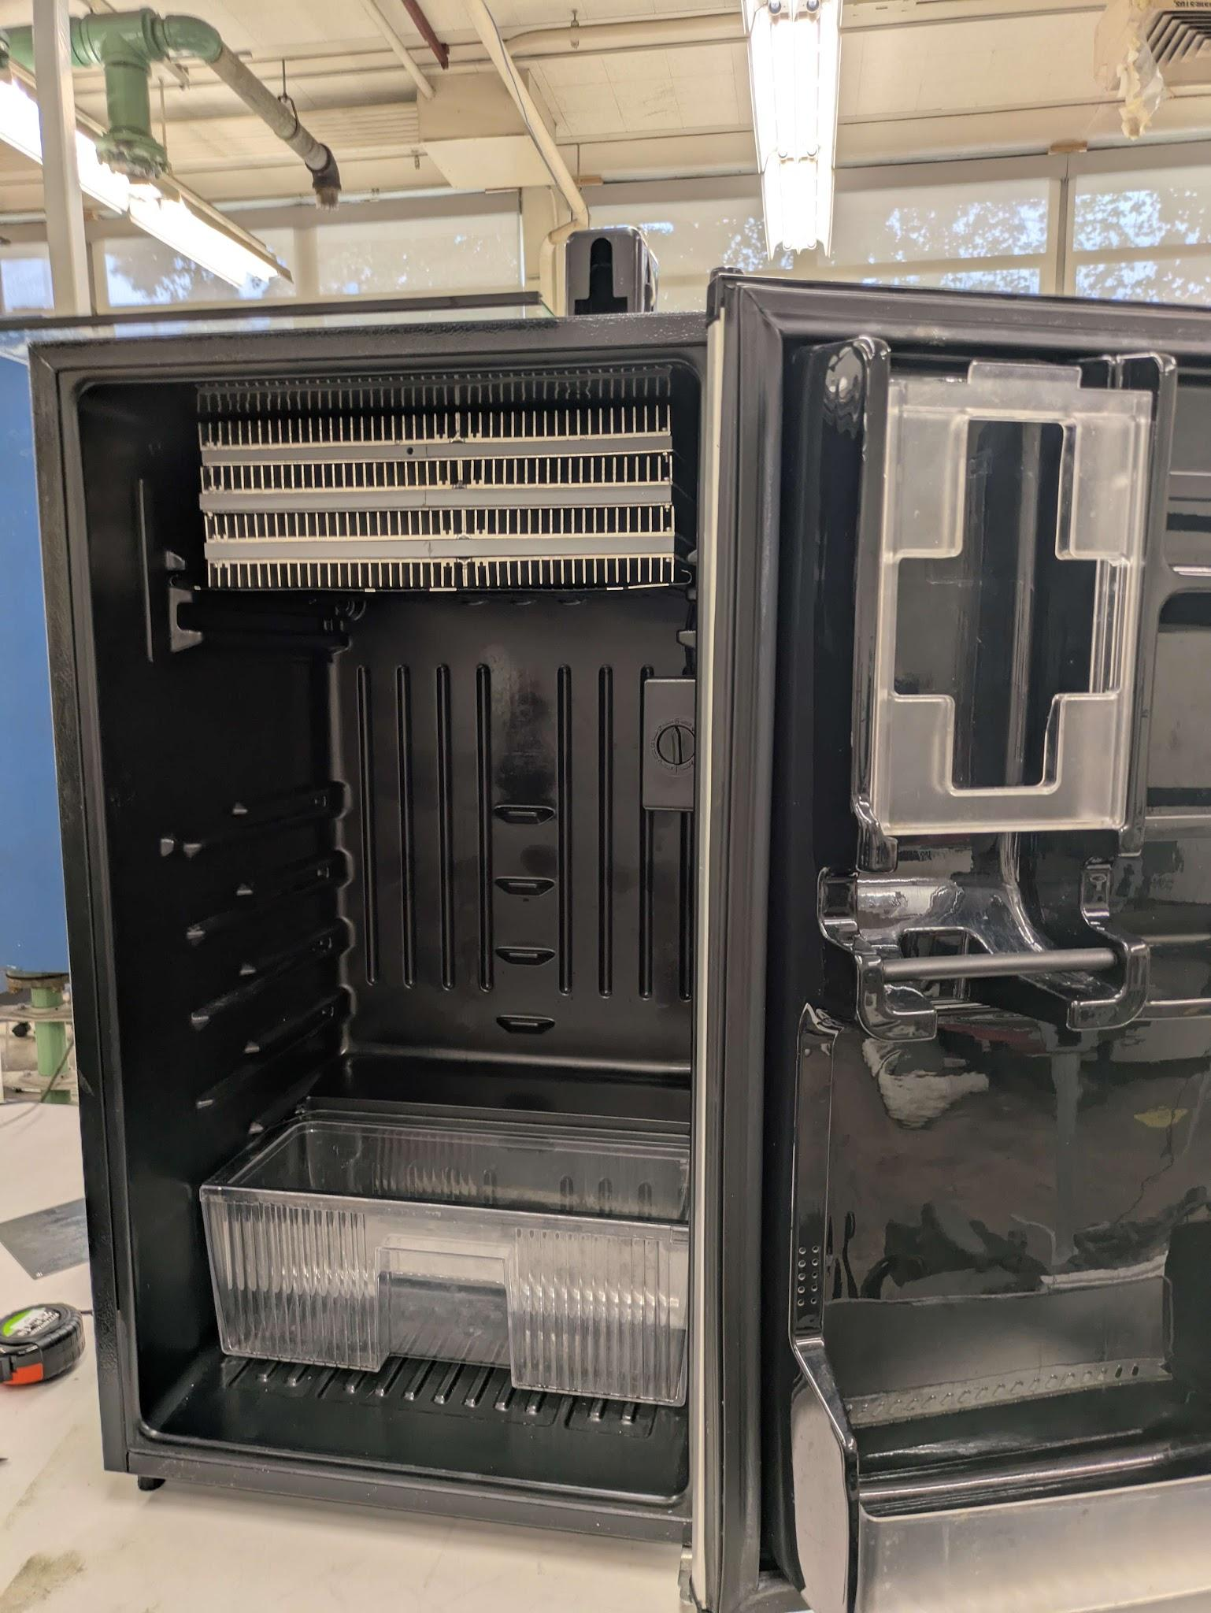
SMART REFRIGERATOR
Isabel Price, Kalino Ruiz, Caleb Mok, Brent Marin, Matthew Manuel
ME-195a
Advisor: Dr. Keith Yi
10/22/2025

Slide 2

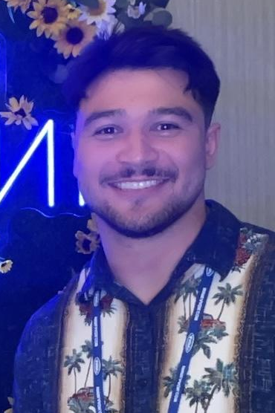




MEET THE TEAM
Kalino Ruiz
Brent Marin
Isabel Price
Caleb Mok
Matthew Manuel

Slide 3
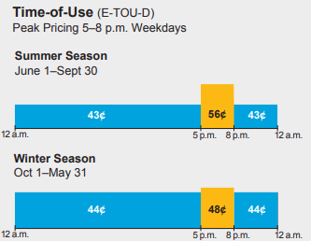
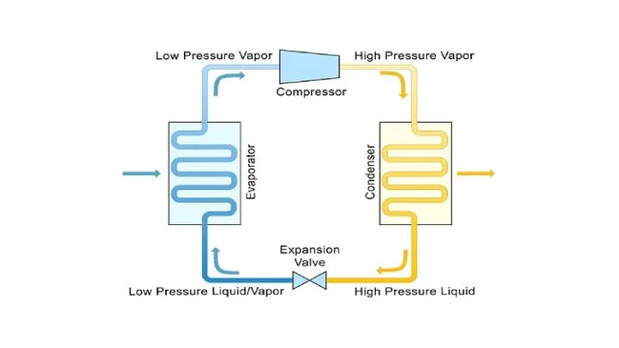
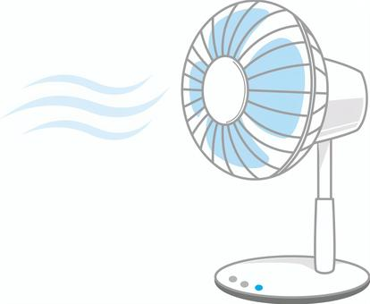

OBJECTIVE/PURPOSE
Goal is to retrofit an existing mini-fridge to use passive cooling during peak utility rates
Thermal storage will be used to create passive cooling
Active Refrigeration Cycle
Passive cooling
Presented by: Kalino

Slide 4
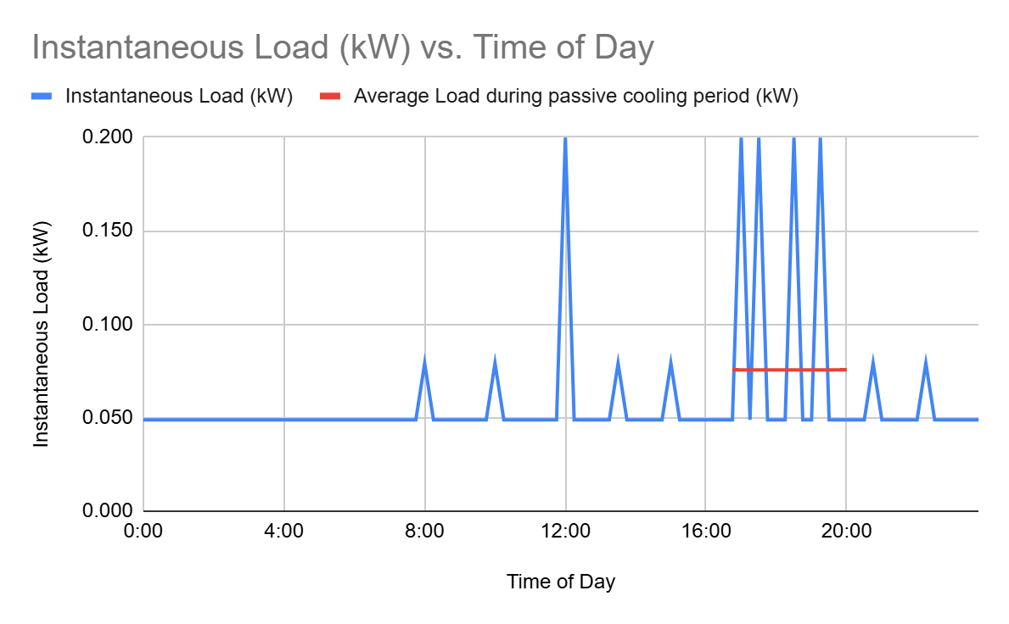
DESIGN SPECIFICATIONS
GROCERY LOAD
During passive cooling period (5-8pm)
Sum of load: 546 kJ
Average load: 51 W
Ice Required: 1.63 kg / 0.0018 m³ / 109 in³
Refrigerator must be at or below 40°F (4°C)
Freezer temperature: 0°F
FDA, Consumer Product Safety Commission(CPSC)
Mini-fridge Specs
Total Internal Storage: 3.7 ft³
Freezer Compartment:
Height: 5 in
Width: 14 in - 15.75 in
Depth: 12.35 in
SOURCE: Food and Drug Administration (FDA)
SOURCE: Consumer Product Safety Commission (CPSC)
Presented by: Matthew
Notes:
The sum of load of initial calculations grocery load combined with the load lost through walls was calculated to be about 51 watts on average. In order to account for this load to run our passive cycle during this high utility rate period, the volume of ice required was about 109 cube inches.
M of water = cooling load
Total cooling Load

Slide 5
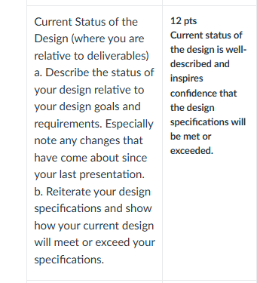
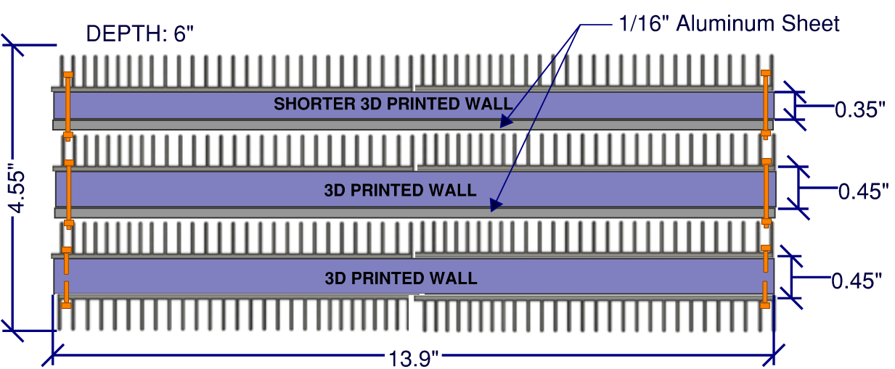
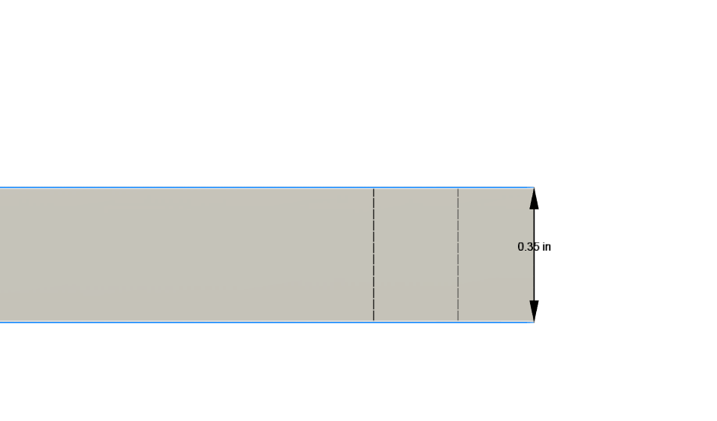
CURRENT STATUS OF DESIGN
Heat Sink
We settled on the design below, however, our first assembly did not fit inside the fridge. To compensate, the final design has one layer of 3D printed walls slightly shorter than the others.
Presented by: Kalino
Notes:
Caleb

Slide 6
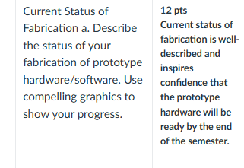
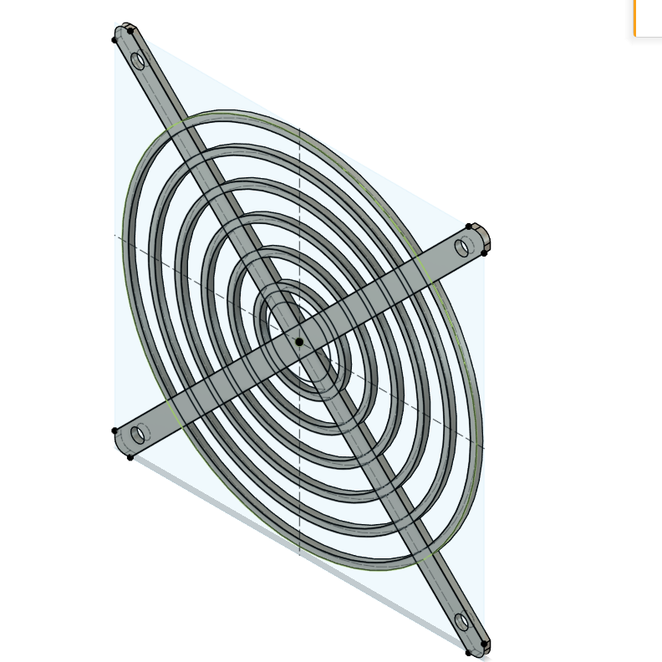
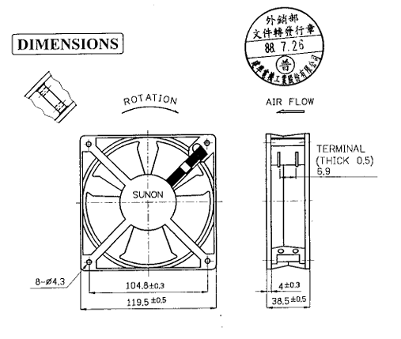
CURRENT STATUS OF DESIGN
Fan
talk about warping.
Status of our cutting
Cut vs Uncut -> compare and contrast
Plan for flattening the warping
Presented by: Kalino

Slide 7
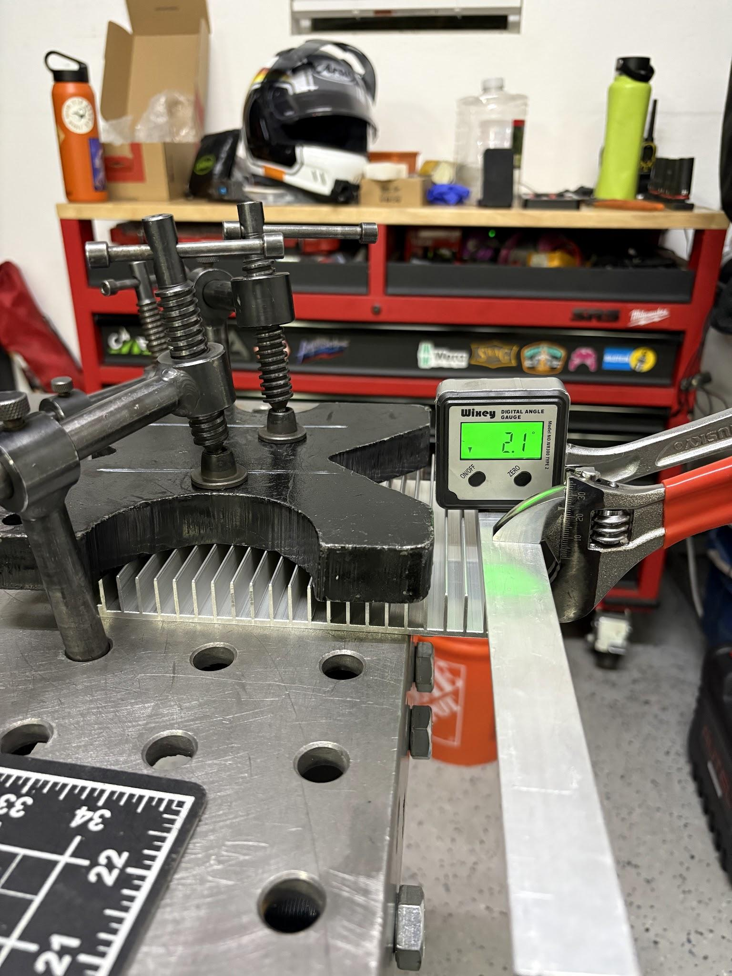
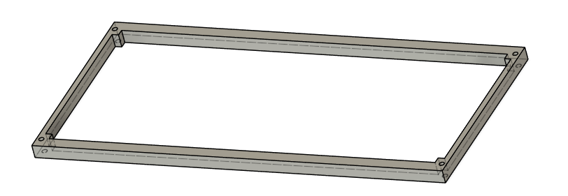
CURRENT STATUS OF CONSTRUCTION
Heat Sink
Presented by: Caleb

Slide 8
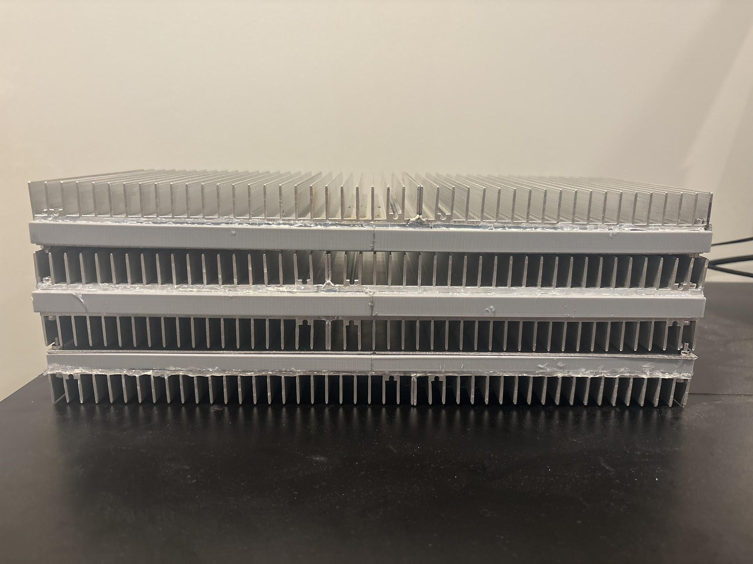
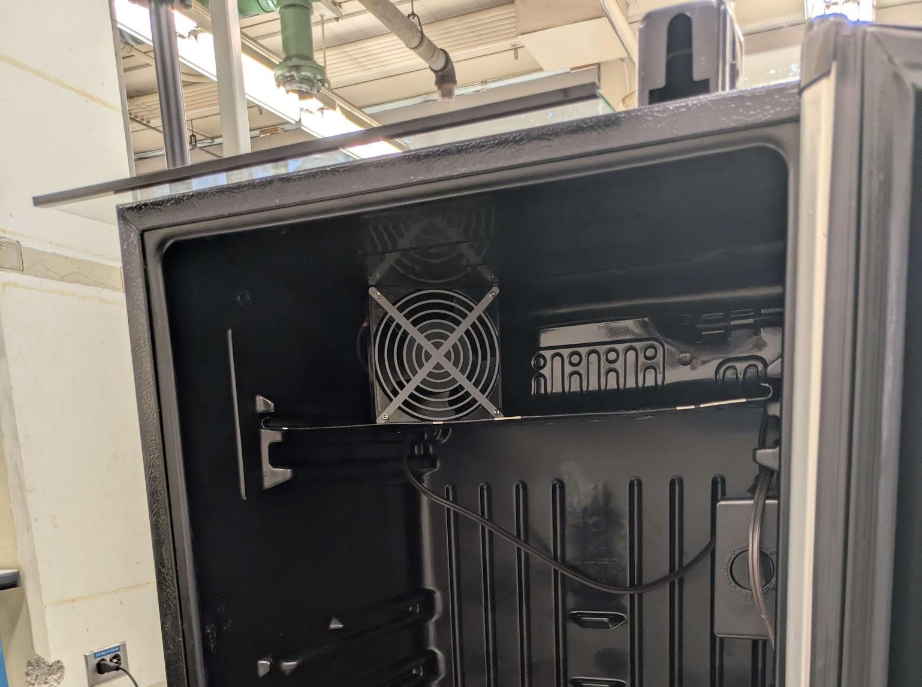
CURRENT STATUS OF CONSTRUCTION
Heat Sink
Presented by: Caleb

Slide 9
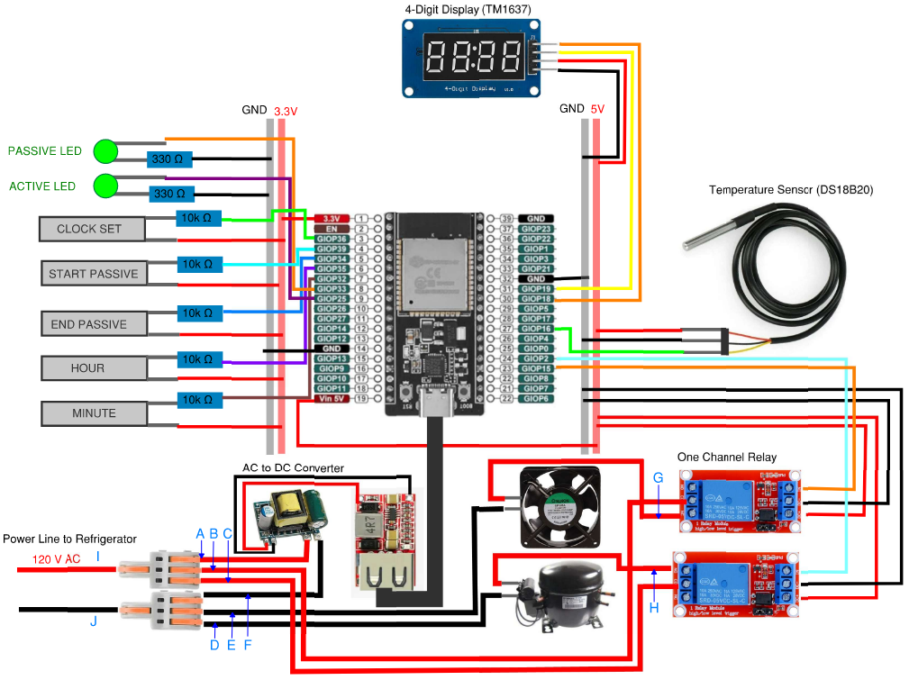
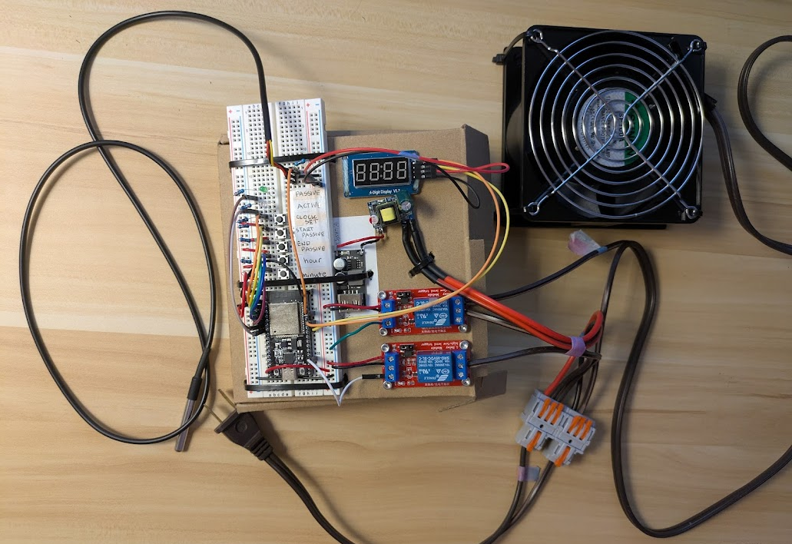
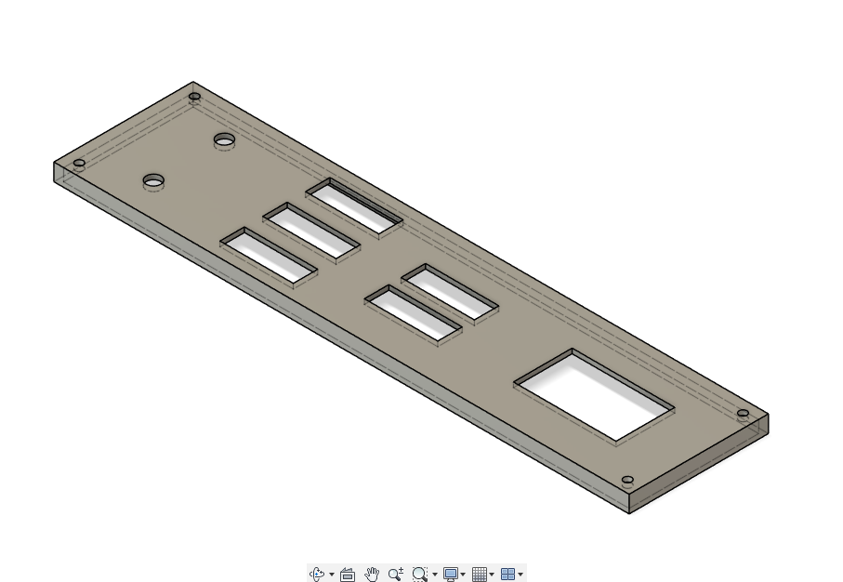
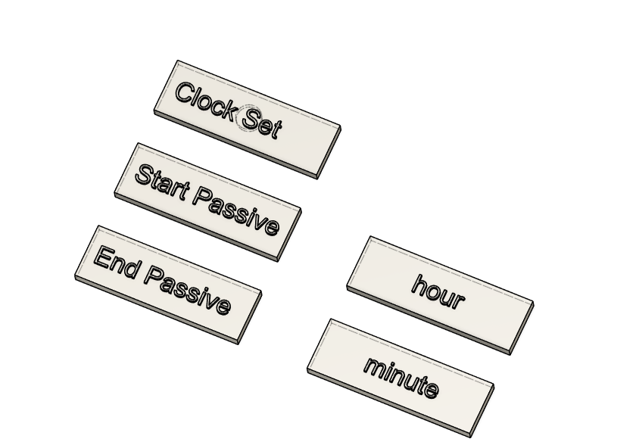
CURRENT STATUS OF PROJECT
Electronics - Prototype Circuit
Prototype Circuit used for development of code and testing of electronic components
Presented by: Isabel
Notes:
Caleb

Slide 10
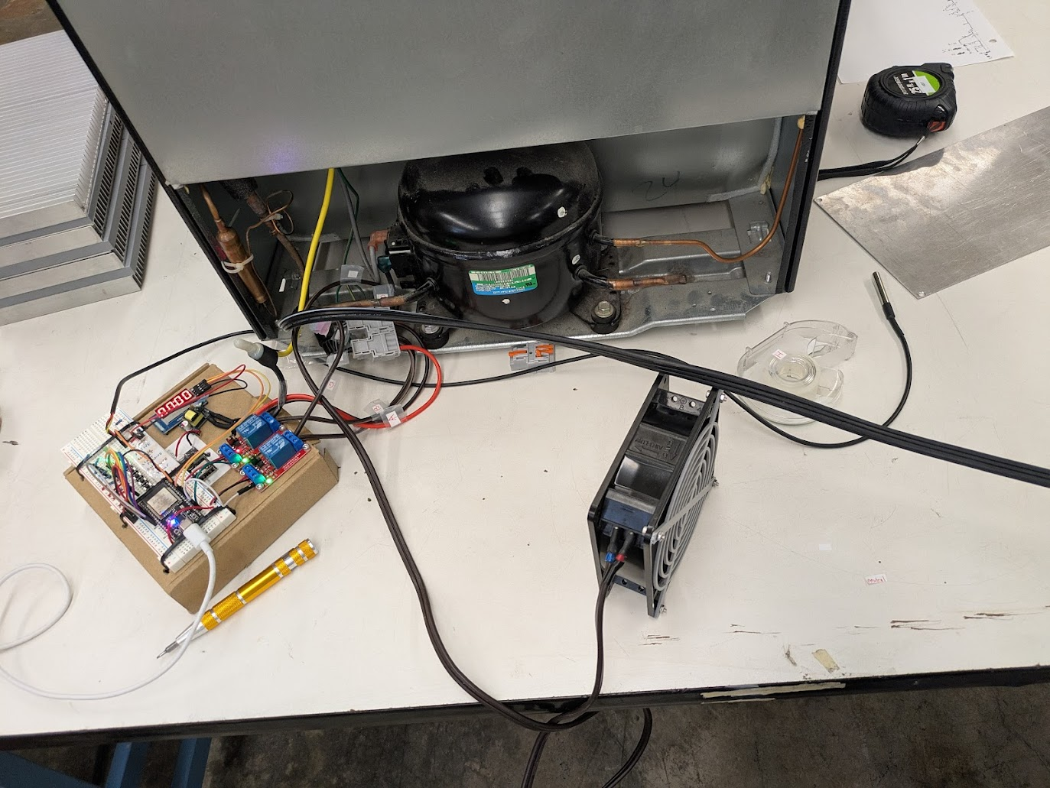
CURRENT STATUS OF CONSTRUCTION
Electronics - AC Connection to Refrigerator
Prototype Circuit designed to be safely and quickly connected and disconnected to the refrigerator’s wiring
Added letters labels to AC wires
AC wiring approved by ENG 141 Lab Technician (Doan)
Presented by: Isabel

Slide 11
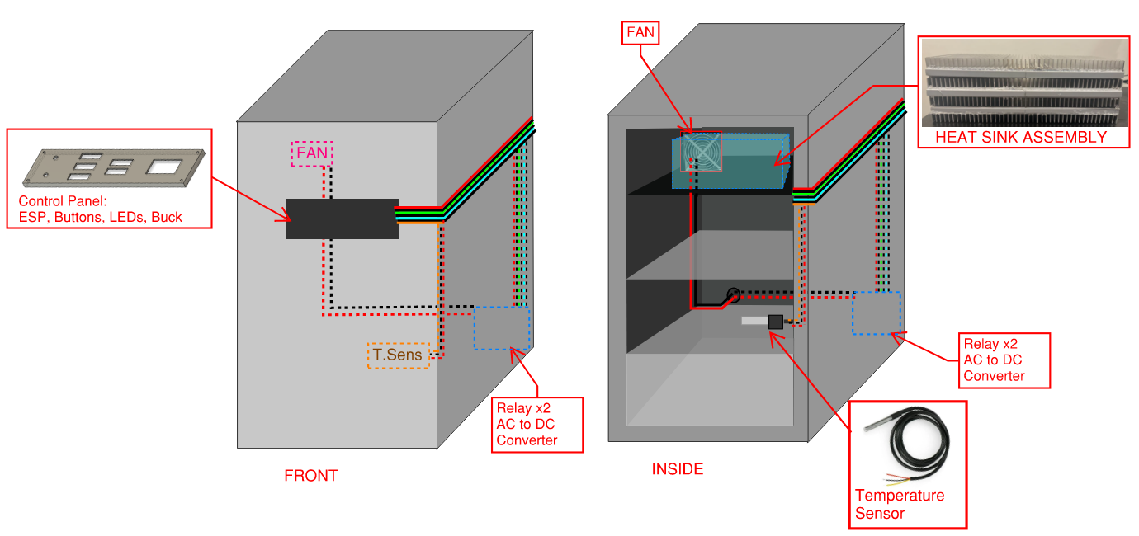
CURRENT STATUS OF PROJECT
Insert some pictures of the control panel
Electronics - Full Refrigerator Circuit Diagram
Presented by: Isabel

Slide 12
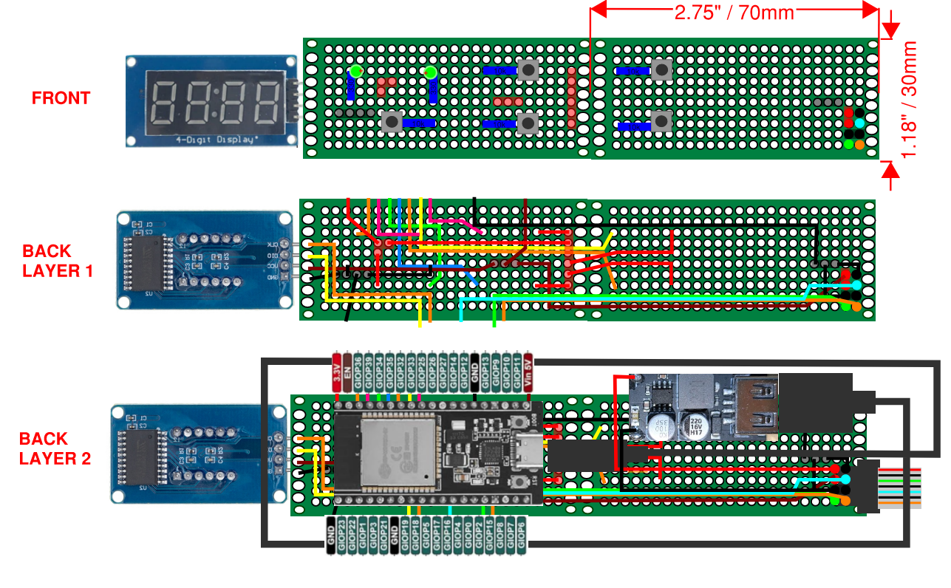
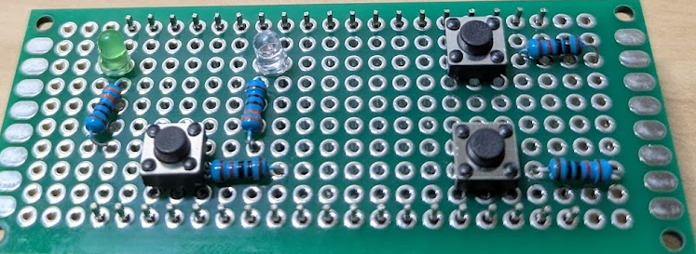
CURRENT STATUS OF PROJECT
Electronics - DIY PCB Diagram
Used two 70mm x 30mm DIY soldering boards
Control panel includes:
Buttons, LEDs, 4-Digit Display, ESP32, Buck, Ribbon wire connector, USB cable, Resistors
Potentially addition: DS3231 Clock Module (22mm x 38mm)
ESP Pins pointing upwards – wiring must wrap around the edge
Presented by: Isabel

Slide 13
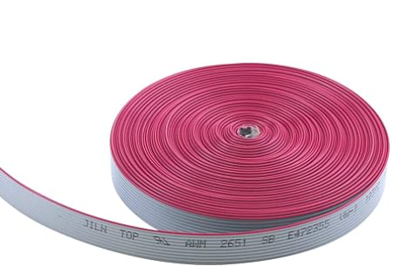
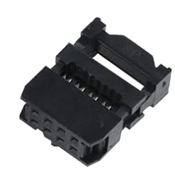
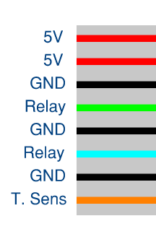
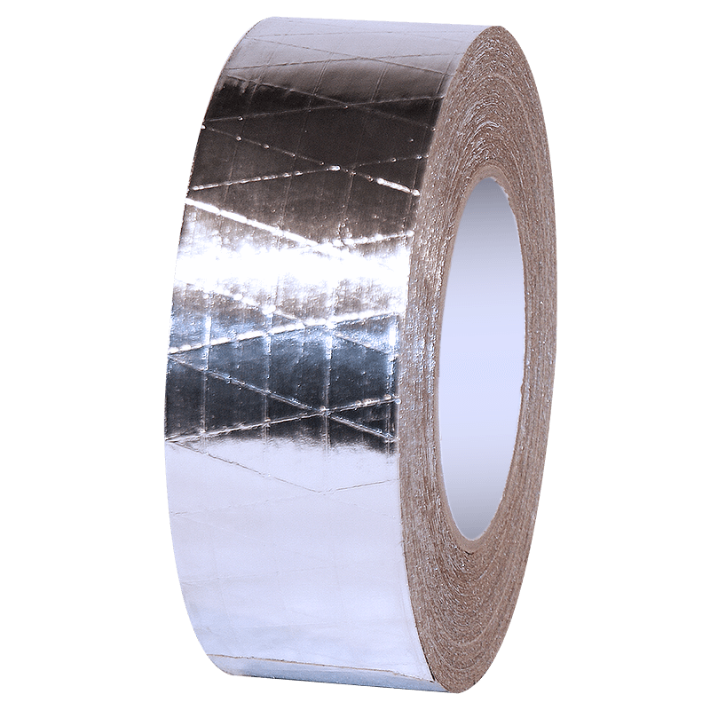
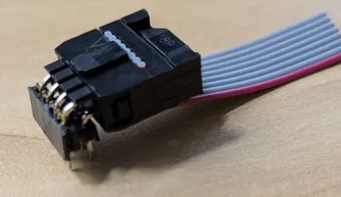
CURRENT STATUS OF PROJECT
Electronics - Ribbon Cable
Signal traveling long distance
Potential for electrical noise
Alternating neutral and signal wires
Two 5V power wires
Wrap in grounded foil tape
Black tape over foil for clean finish
IDC Connector
Presented by: Isabel

Slide 14
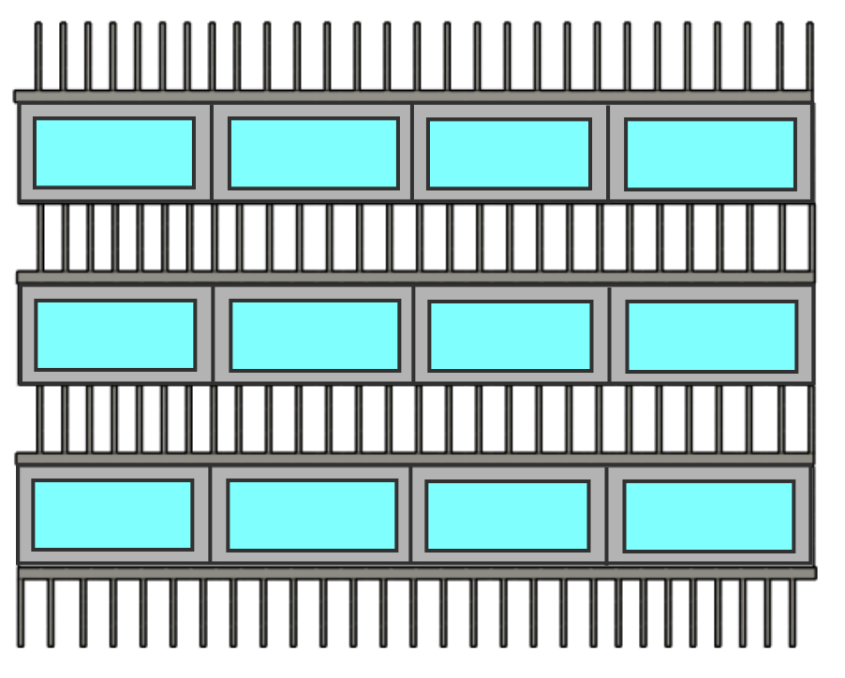
CURRENT STATUS OF DESIGN
Redesign for not discharging refrigerant
Keep freezer section stock instead of cutting evaporator coil to create a larger freezer section
Risk damaging active cycle without testing our hypothesis
Replace metal tubing, our previous thermal storage enclosures, with 3D printed rectangular enclosures
Reduction in overall volume to create a prototype that would fit (vertically & horizontally)
New design eliminates double and inner layers allowing for more ice volume in less overall volume
Presented by: Brent
Notes:
Sadly, we decided not to cut the refrigeration lines to avoid risking our second refrigerators active cycle. We were originally planning on doing this to make the freezer section larger, but we will instead be choosing a more safe route to test our hypothesis of will the ice storage save us more money. To adjust, we choose to shrink our thermal storage prototype to fit in to the freezer. One key factor was the height, and to reduce this we opted for a more practical design that eliminates double layers and internal metal volume where more ice can be. Kalino will talk about the 3D printed design that will increase heat transfer in the airflow vanes of the heat sinks.

Slide 15
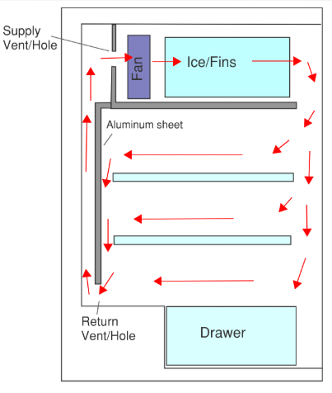
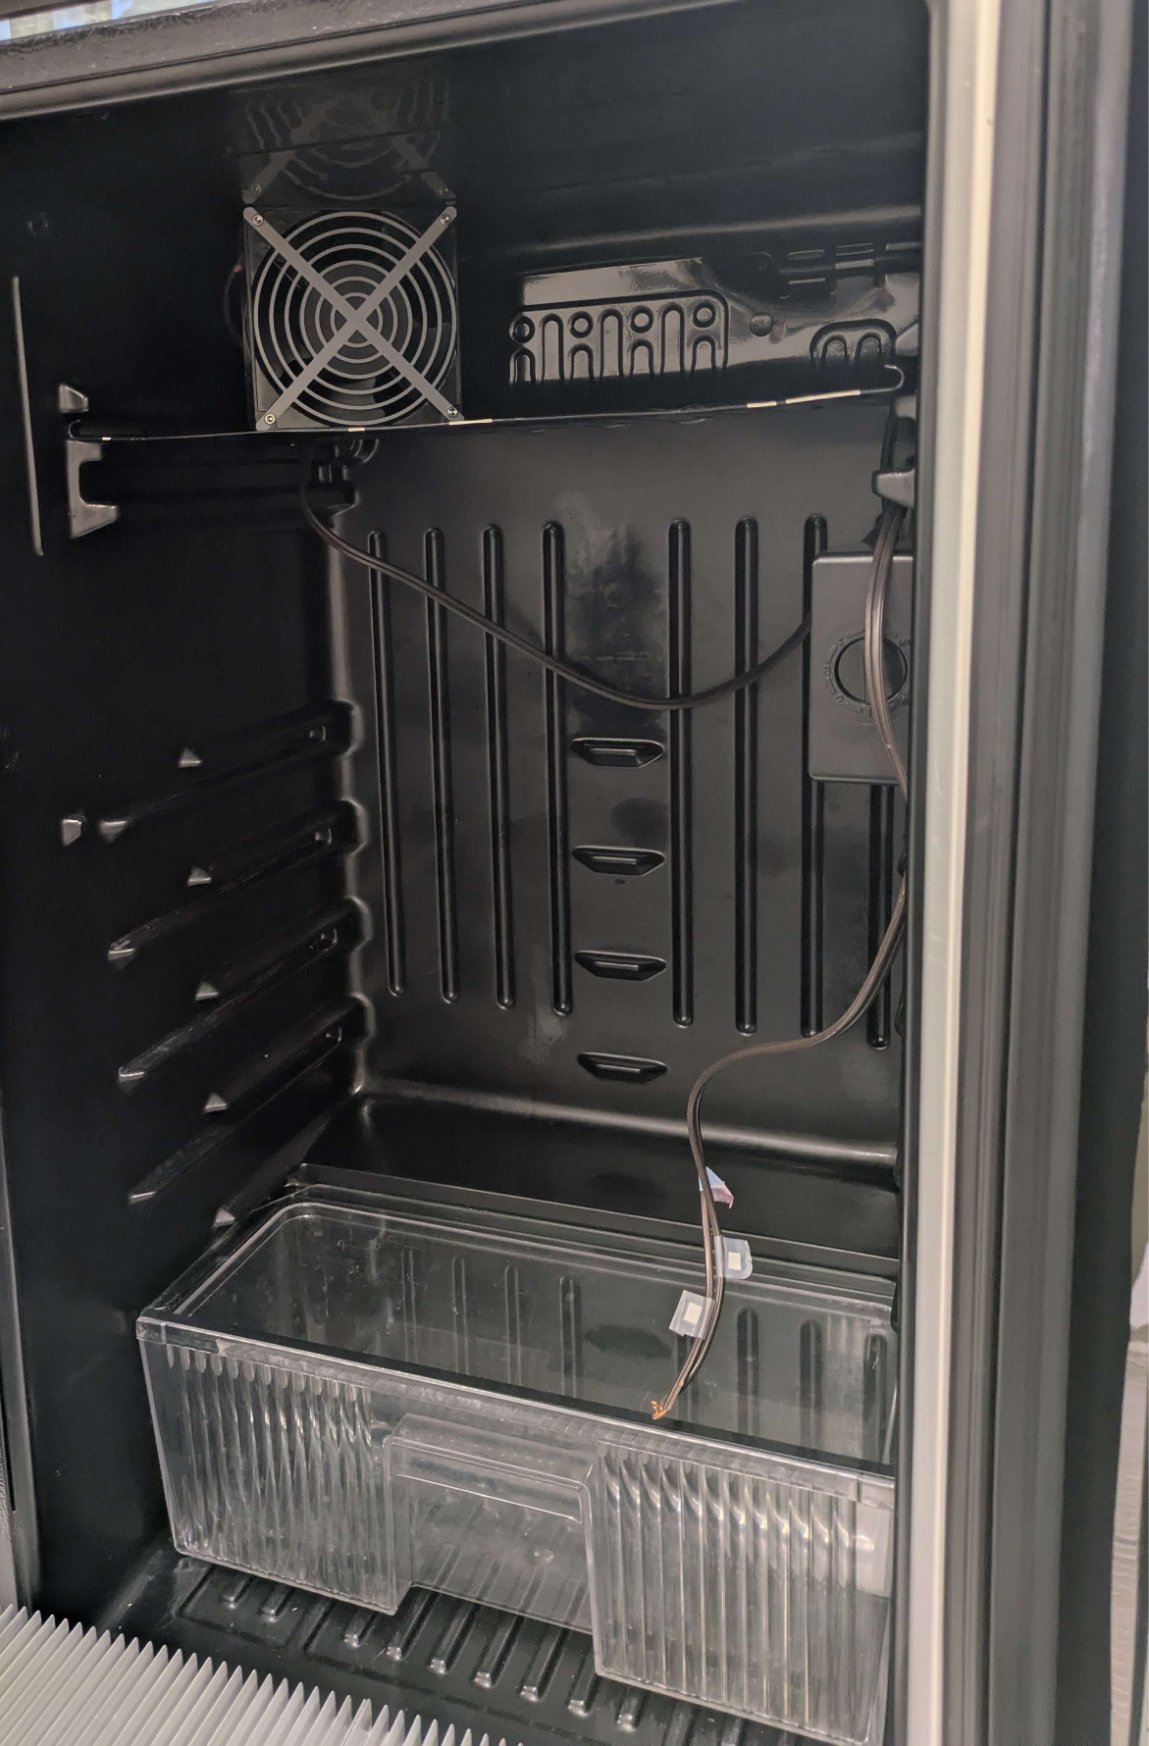
CURRENT STATUS OF DESIGN
Return Vent
1 inch from back inner wall
Leave space underneath vent to allow return air to circulate
Measured around side inner walls and are currently on revision two of adjusting measurements
Presented by: Brent
Notes:
Sadly, we decided not to cut the refrigeration lines to avoid risking our second refrigerators active cycle. We were originally planning on doing this to make the freezer section larger, but we will instead be choosing a more safe route to test our hypothesis of will the ice storage save us more money. To adjust, we choose to shrink our thermal storage prototype to fit in to the freezer. One key factor was the height, and to reduce this we opted for a more practical design that eliminates double layers and internal metal volume where more ice can be. Kalino will talk about the 3D printed design that will increase heat transfer in the airflow vanes of the heat sinks.

Slide 16
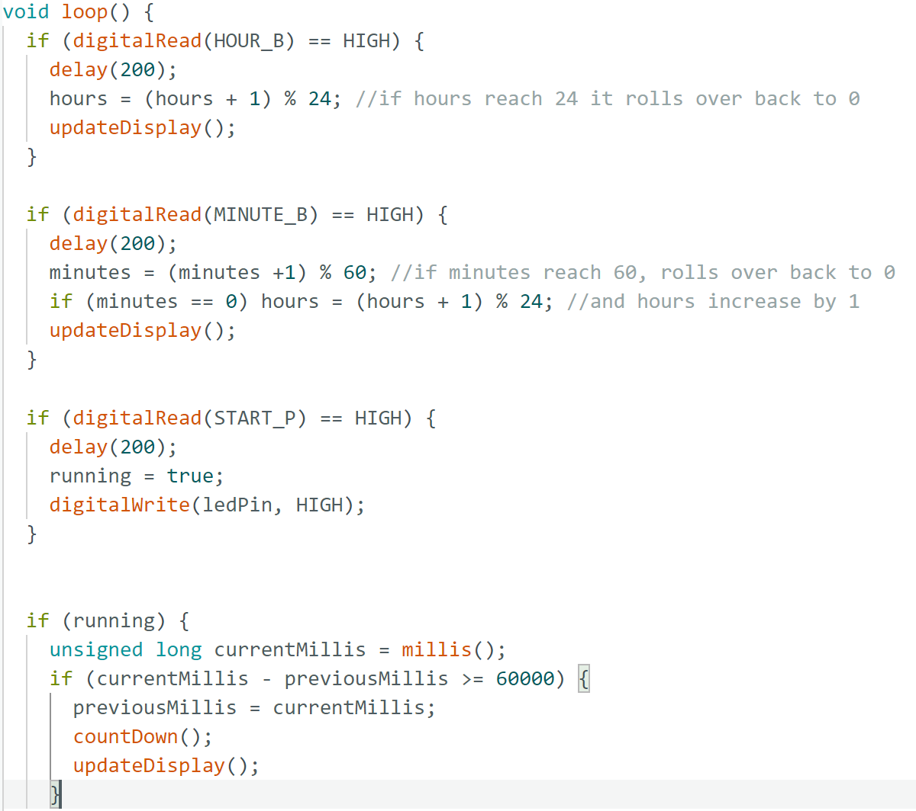
CURRENT STATUS OF DESIGN
Coding
Full control panel code
Active mode connecting to compressor
Passive mode connecting to fan and temperature sensor
When passive mode is on:
Compressor off
Fan periodically blows air over heat sinks at a certain temperature
Presented by: Matthew
Notes:
Caleb

Slide 17
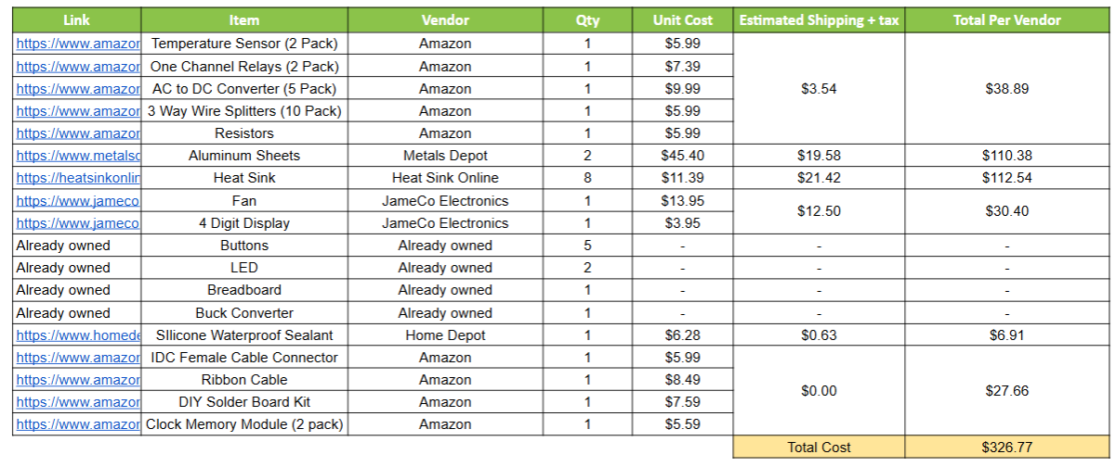
BUDGET/BOM
Last remaining item necessary: Graduated Cylinder
Approved order from ME department: $460
After discharging refrigerant rework: $327
Presented by: Matthew

Slide 18
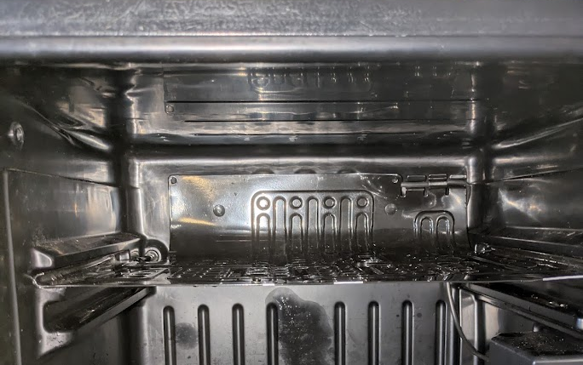
Dependencies
Fan and Ice Assembly Fits in the Freezer
Sufficient Airflow and cooling for safe food storage
Fan
Back of Evaporator
Freezer Compartment
Ice Casing Assembly
Presented by: Caleb

Slide 19
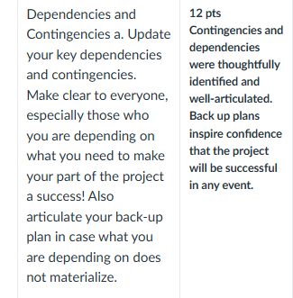
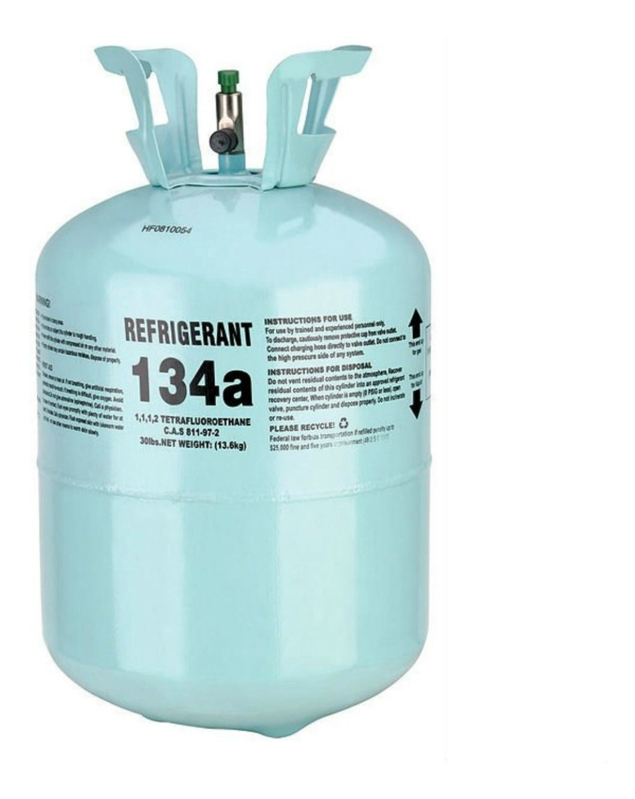
Contingencies
If the refrigerator can’t supply enough cooling, we will attempt to modify the compressor to increase ice volume
Potential Risks and Contingencies that will arise
Finding a certified technician to help us or getting certified, working with R-134a for the first time, and buying or renting additional tools to perform this ourselves
If we cannot fit wire through door opening, we must drill into walls
Presented by: Brent
Dependencies: The refrigerator compressor working and can freeze all of the ice.
Fan and ice assembly fits in the freezer
Contingencies
The awful discharge and recharging thing.

Slide 20
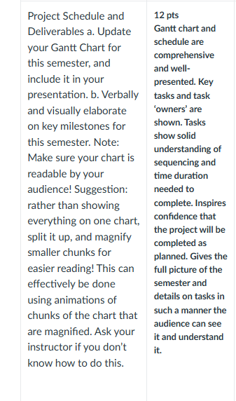
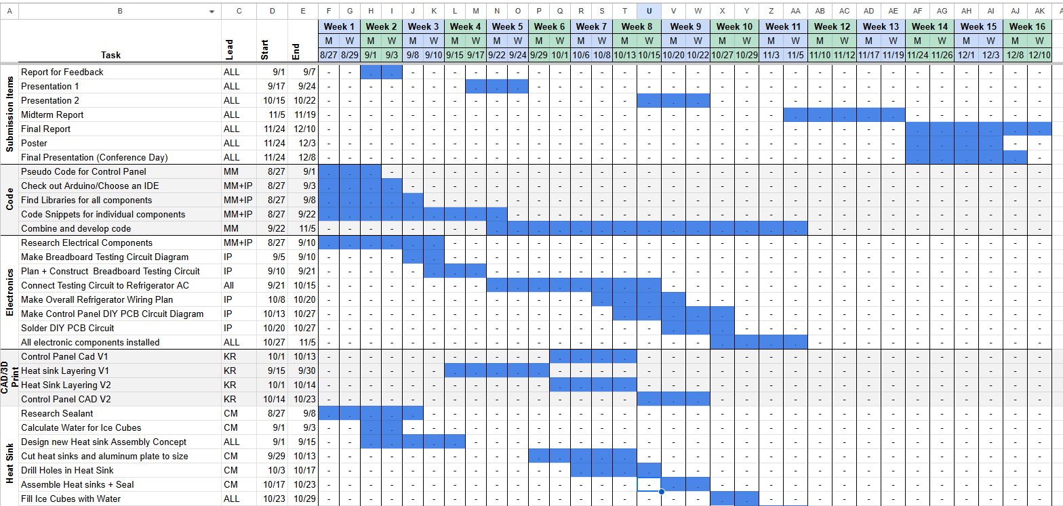
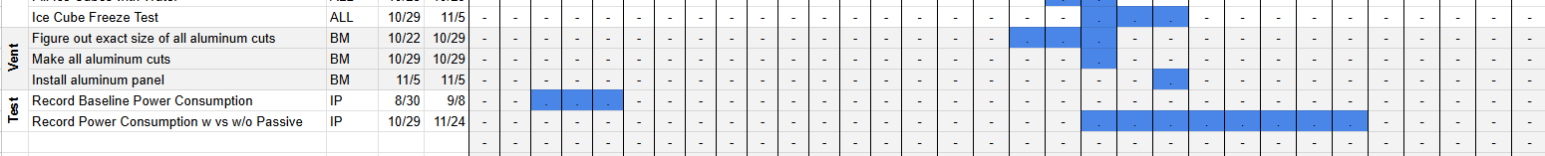
PROJECT PROCESS AND MILESTONES
GANTT CHART
Presented by: Caleb

Slide 21
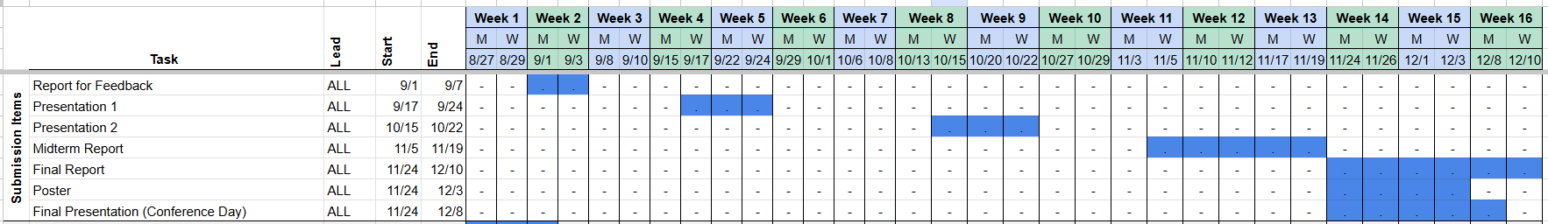
PROJECT PROCESS AND MILESTONES
GANTT CHART
Presented by: Caleb

Slide 22
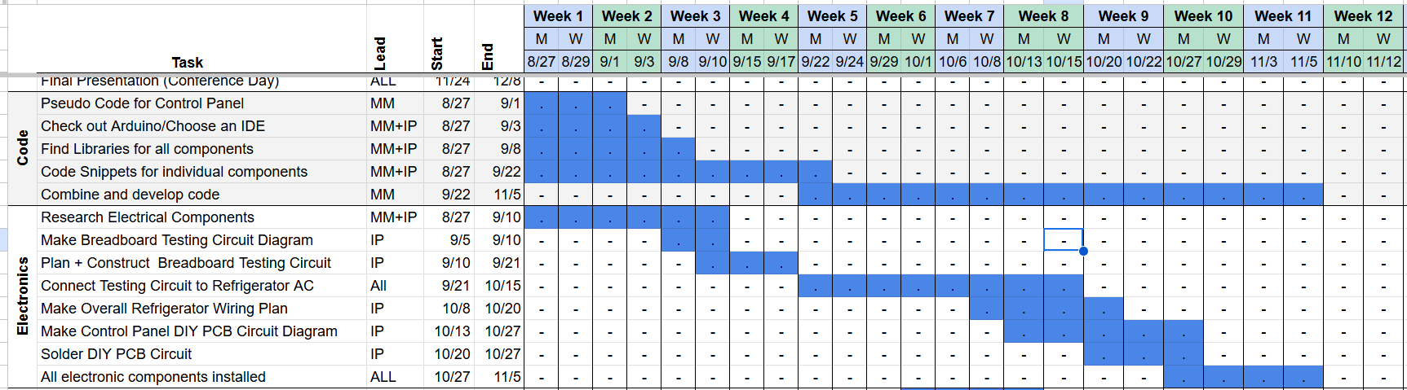
PROJECT PROCESS AND MILESTONES
GANTT CHART
Presented by: Caleb

Slide 23
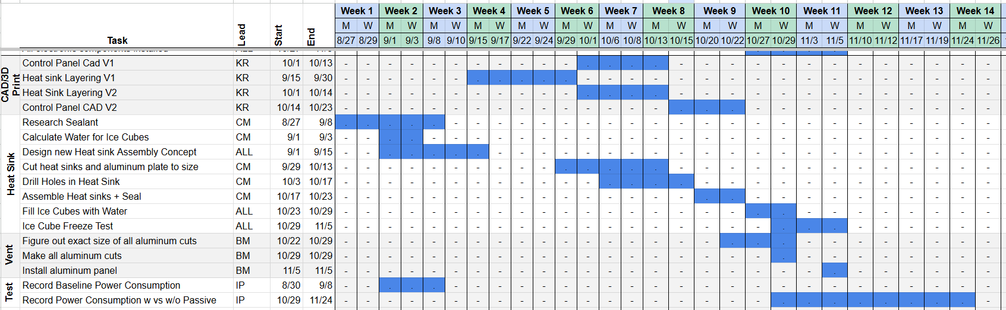
PROJECT PROCESS AND MILESTONES
GANTT CHART
Presented by: Caleb

Slide 24

NEXT STEPS
Remaining Steps of Project:
Fill heatsink assembly with water
Solder control panel
CAD + assemble shell of control panel
Final wiring (Drilling holes where necessary)
Continue development of code to implement all features
Cut the aluminum and install the return vent
Use PGE Power recorder to evaluate performance
Presented by: Caleb
Notes:
Caleb

Slide 25

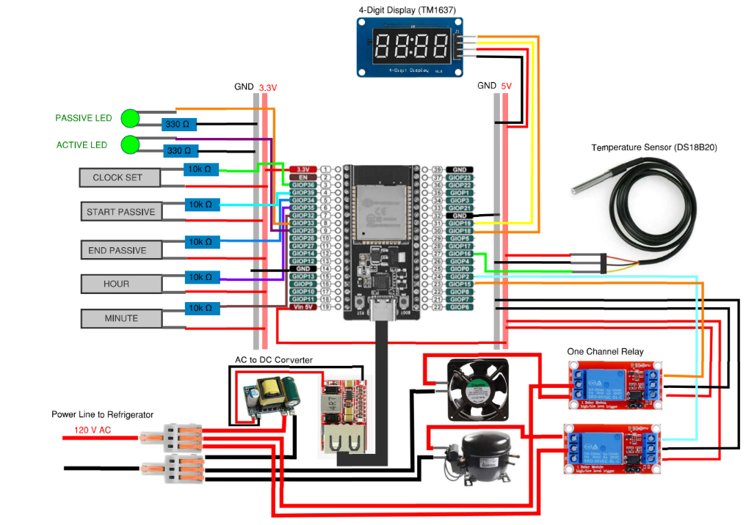
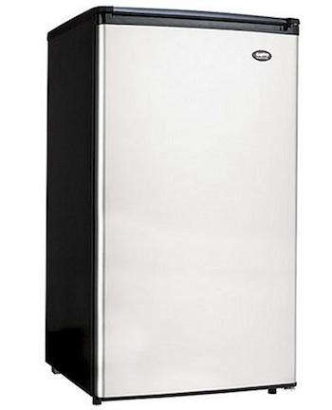
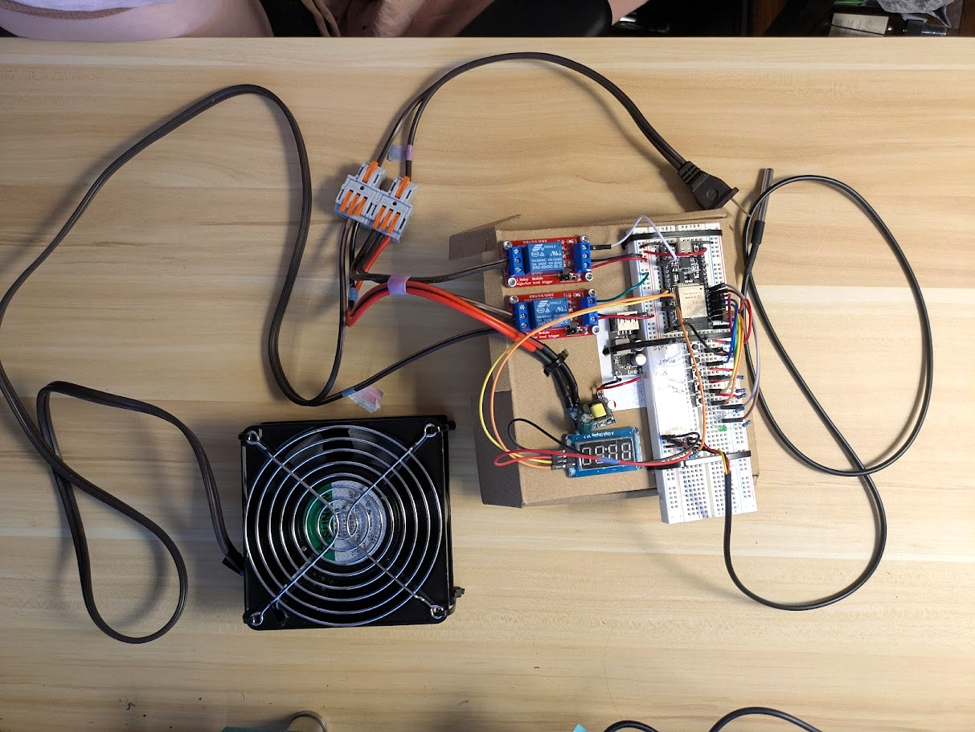
THANK YOU FOR YOUR ATTENTION!

Slide 26
QUESTIONS?

